Slide 1

TIC TAC TOE ARENA
by
BHUVISHA GOHIL
150096725190

Slide 2
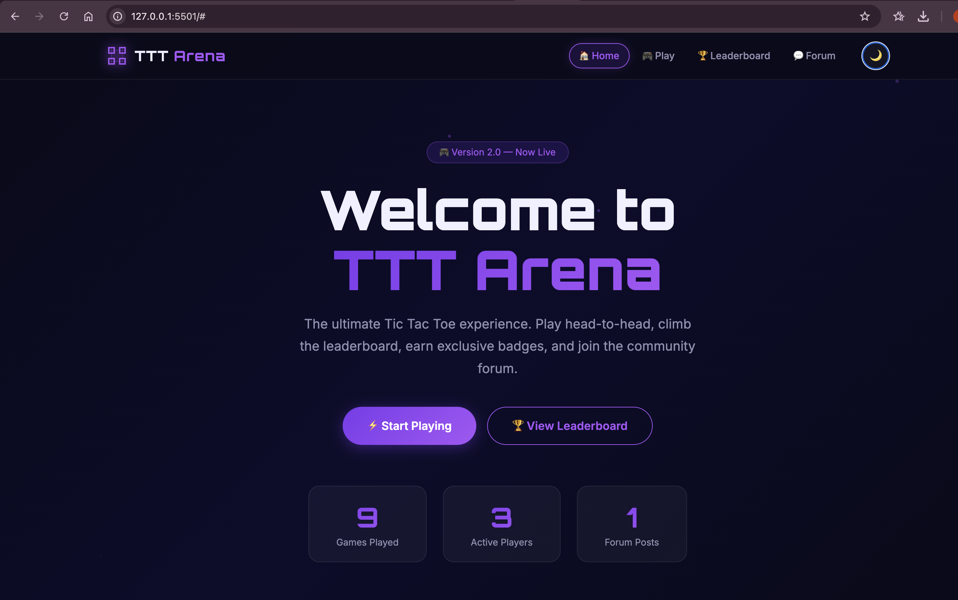

Problem Statement
Most existing online Tic Tac Toe games are very simple and only provide the basic gameplay experience. They generally lack advanced features that make the game more engaging for users.
Some common limitations include:
No score tracking system across multiple matches
Lack of player progression or ranking system
No customization options such as themes or UI settings
Absence of community interaction features like forums
No motivation for players to continue playing after one game
These limitations reduce user engagement and long-term interaction with the platform.
Objective of the Project
The objective of this project is to design and develop an interactive Tic Tac Toe web application that enhances the traditional gameplay by including additional features such as:
Real-time score tracking
Badge-based ranking system
Leaderboard for player comparison
Theme customization
Forum for discussion and strategy sharing

Slide 3
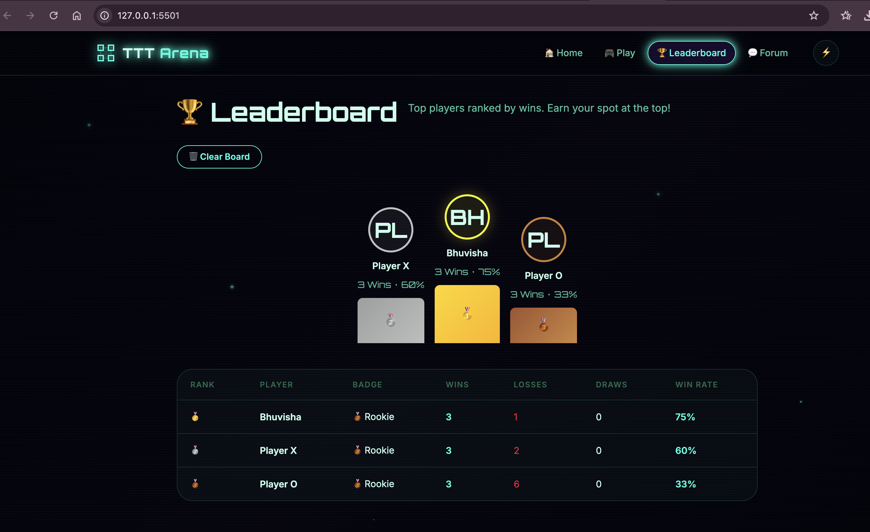
2. Solution
To solve the limitations of traditional Tic Tac Toe games, the project introduces TTT Arena, an advanced browser-based game platform.
TTT Arena is designed to provide a more engaging and interactive user experience while maintaining the simplicity of the original game.
Key features of the system include:
1. Interactive Game Board
A 3×3 grid where players take turns placing X and O.
2. Scoreboard System
Tracks wins, losses, and draws for each player.
3. Badge and Ranking System
Players earn badges based on their performance and number of wins.
4. Leaderboard
Displays top players ranked according to wins and win rate.
5. Community Forum
Allows players to share strategies, ask questions, and interact with other users.
6. Theme Customization
Users can switch between Dark, Neon, and Light themes.
The platform is designed to work entirely within the browser, without requiring server-side integration.

Slide 4
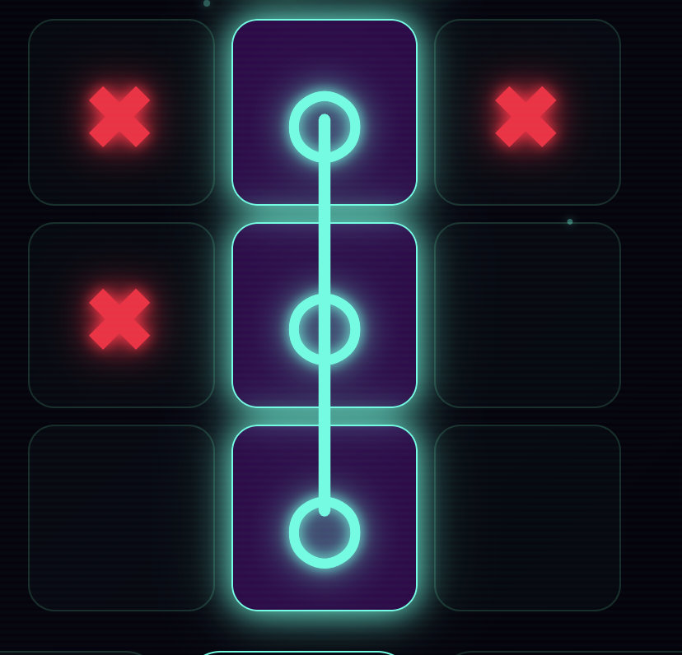
3. Working/Methods & Algorithms.
The game logic is implemented using JavaScript algorithms that control gameplay and determine the outcome of each match.
Game Board Representation
The game board is represented using a 9-element array.
Each element corresponds to a cell in the 3×3 grid.
The value can be X, O, or empty.
Winning Algorithm
After each move, the system checks predefined winning patterns:
Rows:
[0,1,2]
[3,4,5]
[6,7,8]
Columns:
[0,3,6]
[1,4,7]
[2,5,8]
Diagonals:
[0,4,8]
[2,4,6]
If any pattern contains the same symbol (X or O), the system declares a winner.
If all cells are filled without a winning pattern, the game ends in a draw.
Additional Algorithms
Badge assignment based on total wins
Leaderboard ranking using win statistics
Forum post management using localStorage

Slide 5
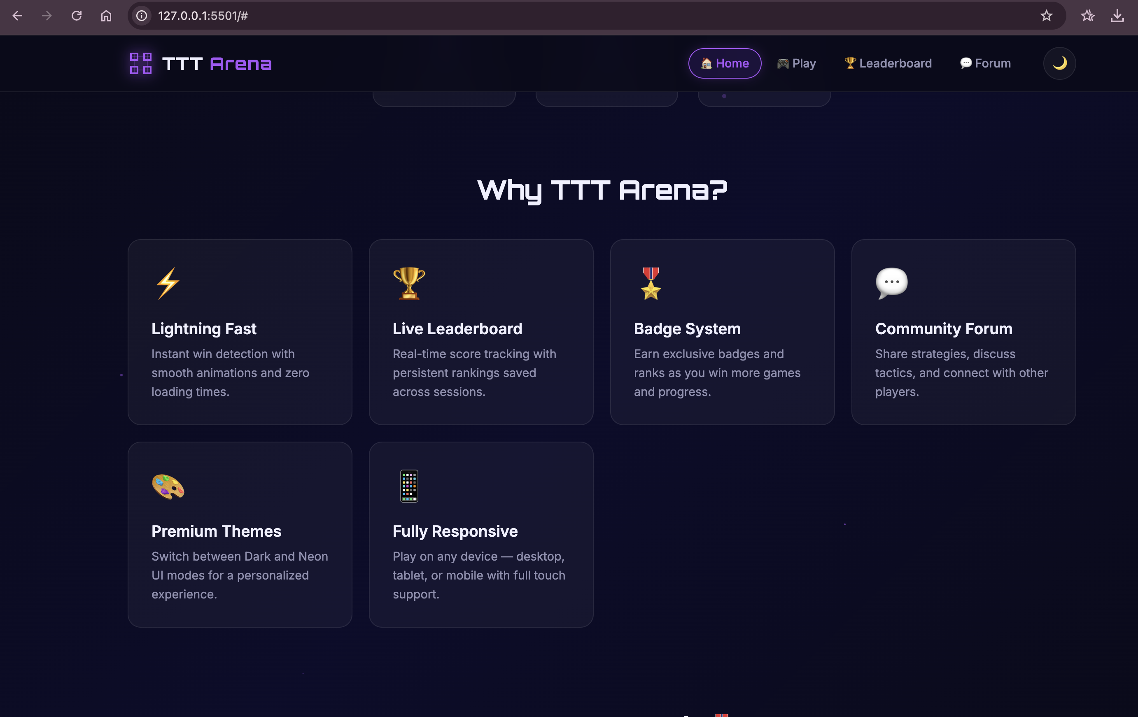
4. Conclusion
The TTT Arena project demonstrates how a simple traditional game can be enhanced using modern web development technologies.
The platform successfully integrates gameplay with interactive features such as:
Real-time score tracking
Leaderboard and badge system
Theme customization
Community discussion forum
These features significantly improve user engagement and overall gaming experience.
The project also demonstrates practical implementation of:
HTML5 for structure
CSS3 for styling and animations
JavaScript for game logic and interactivity
LocalStorage for persistent data storage
Future Enhancements
The system can be further improved by adding:
Artificial Intelligence (AI) opponent
Sound effects and background music
Online multiplayer support
User authentication for multi-device progress

Slide 6
Thank You

